Slide 1
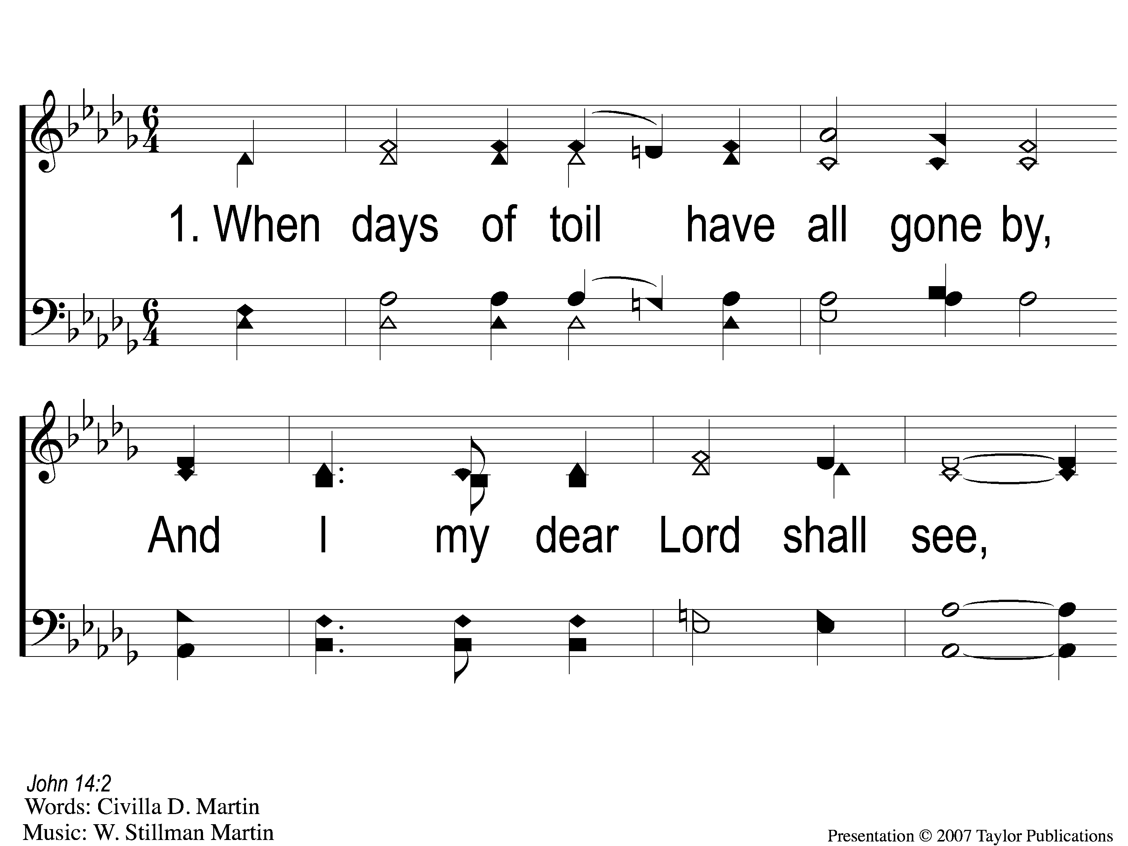
1-1 When Day of Toil Have All Gone By
When Days of Toil Have All Gone By
176

Slide 2
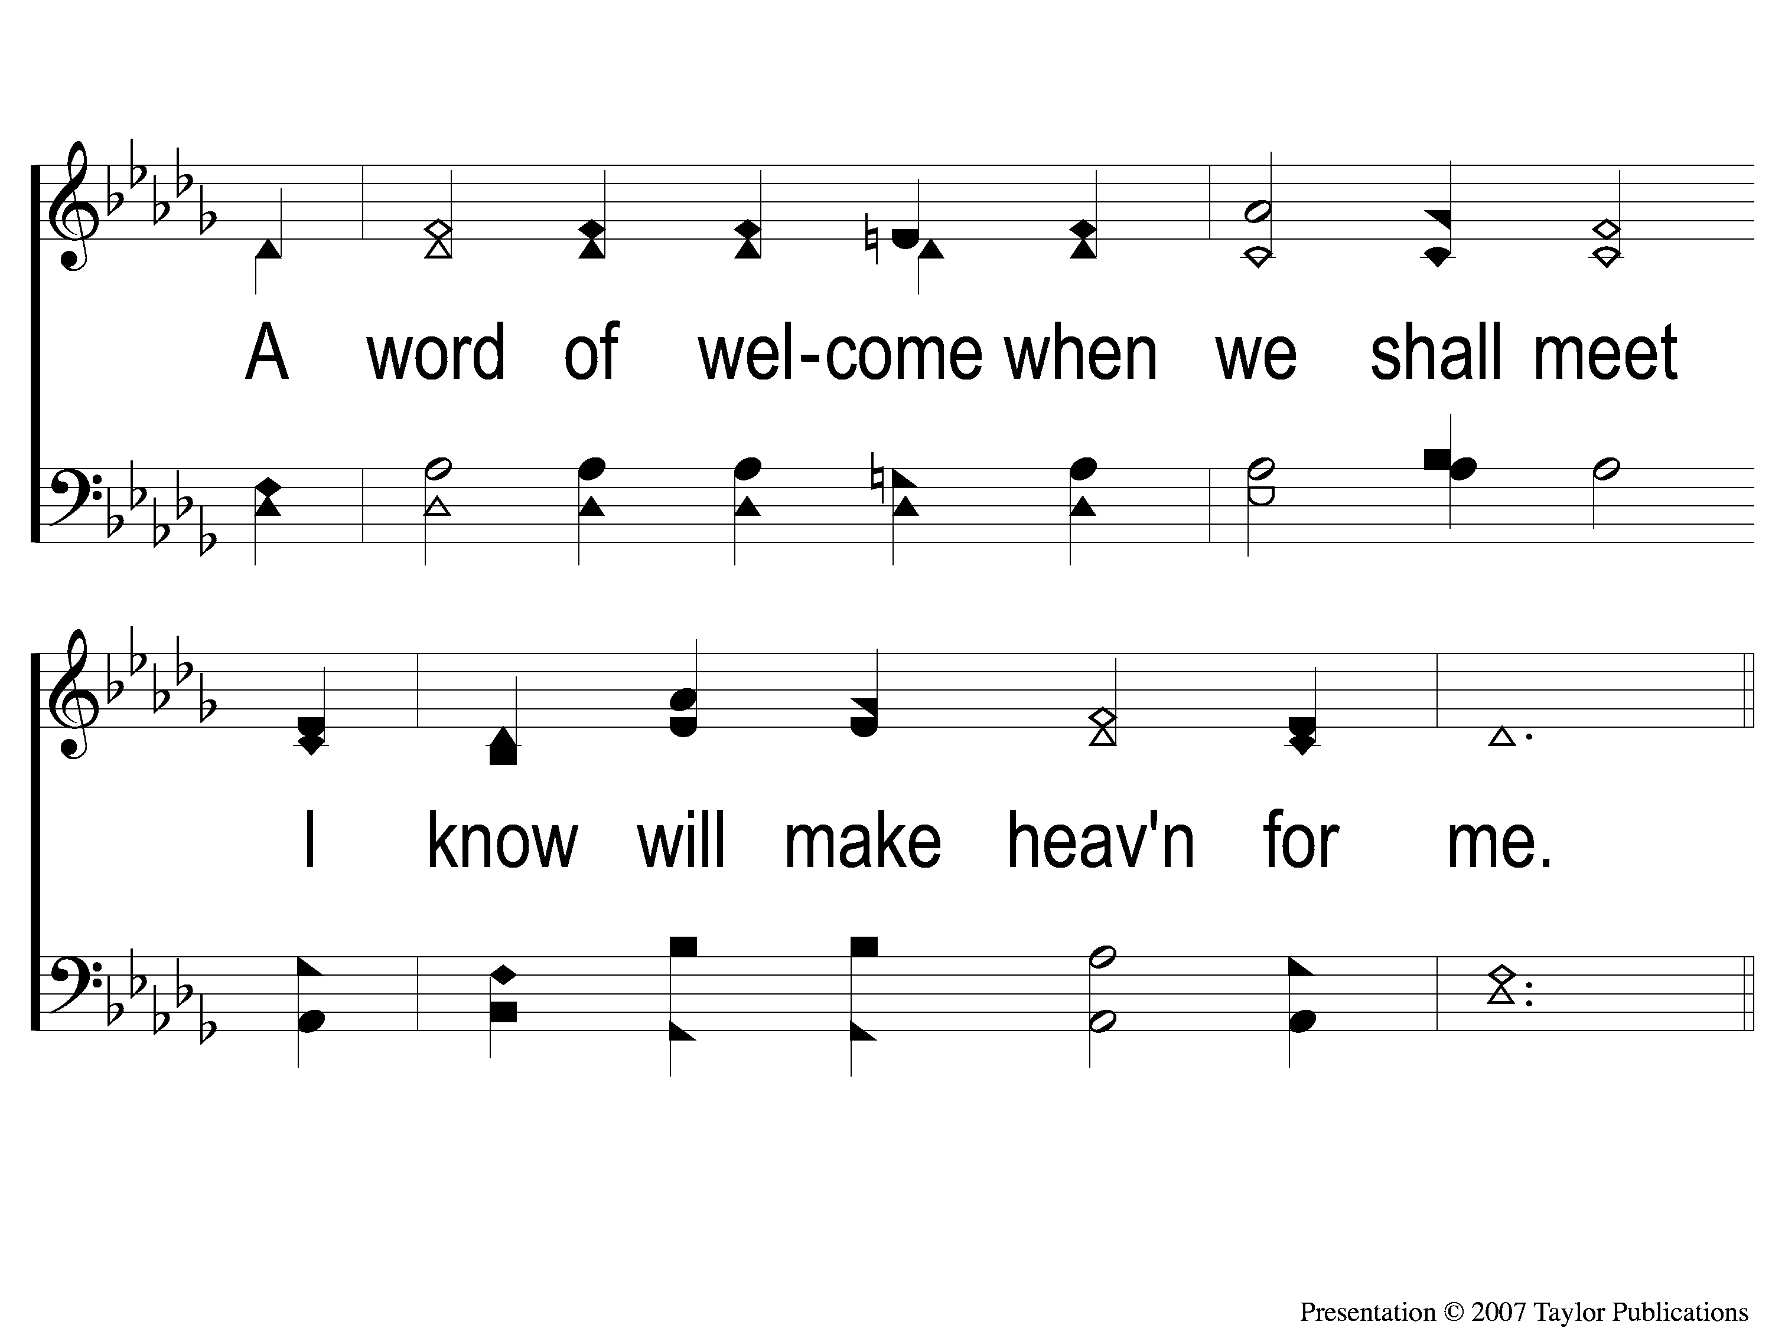
1-2 When Day of Toil Have All Gone By
When Days of Toil Have All Gone By
176

Slide 3
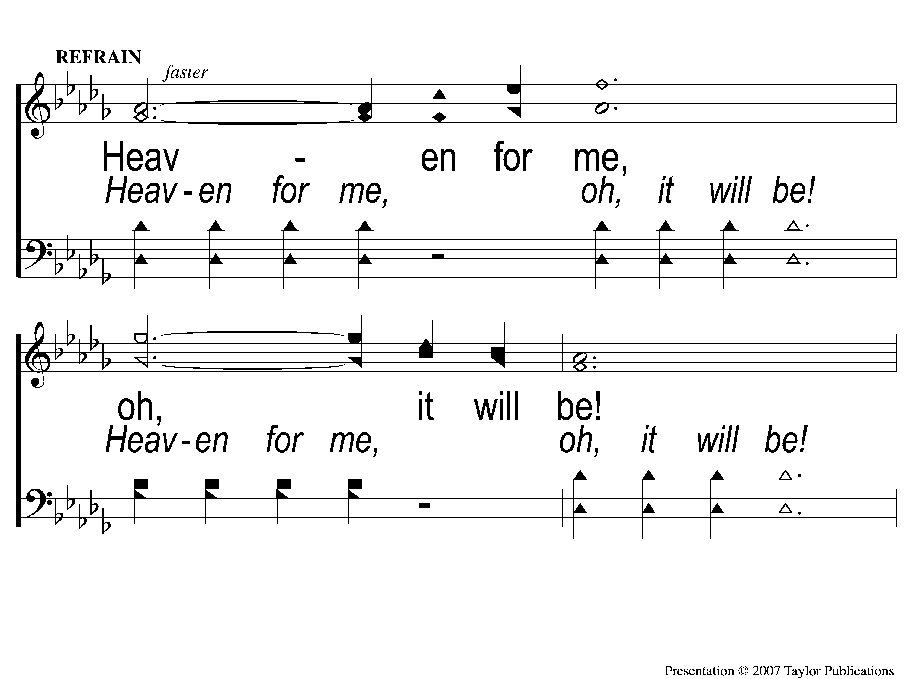
C-1 When Day of Toil Have All Gone By
When Days of Toil Have All Gone By
176

Slide 4
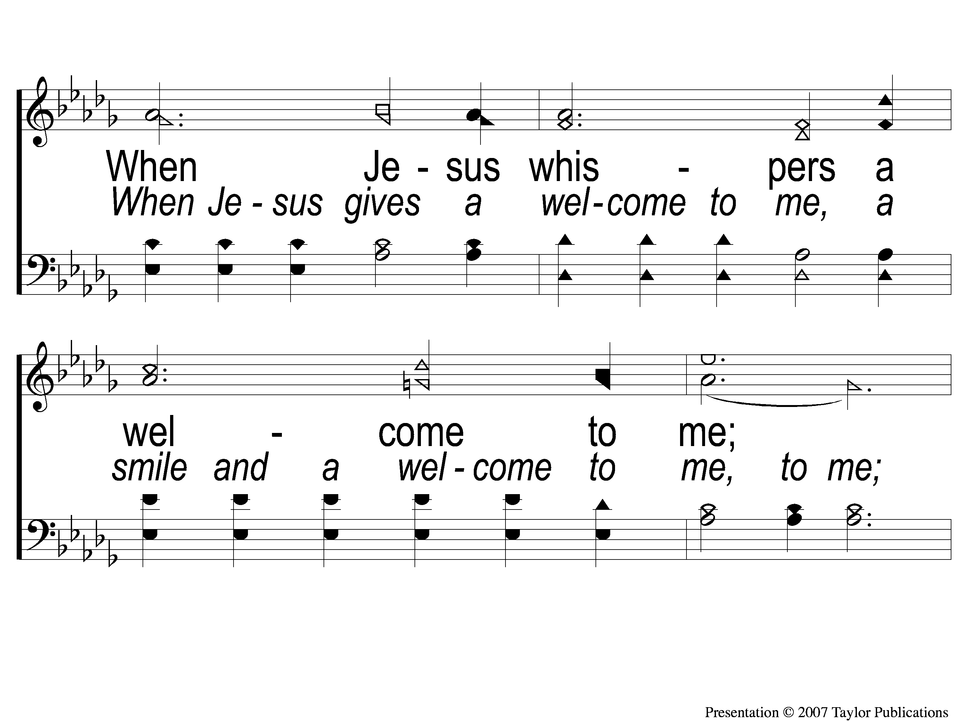
C-2 When Day of Toil Have All Gone By
When Days of Toil Have All Gone By
176

Slide 5
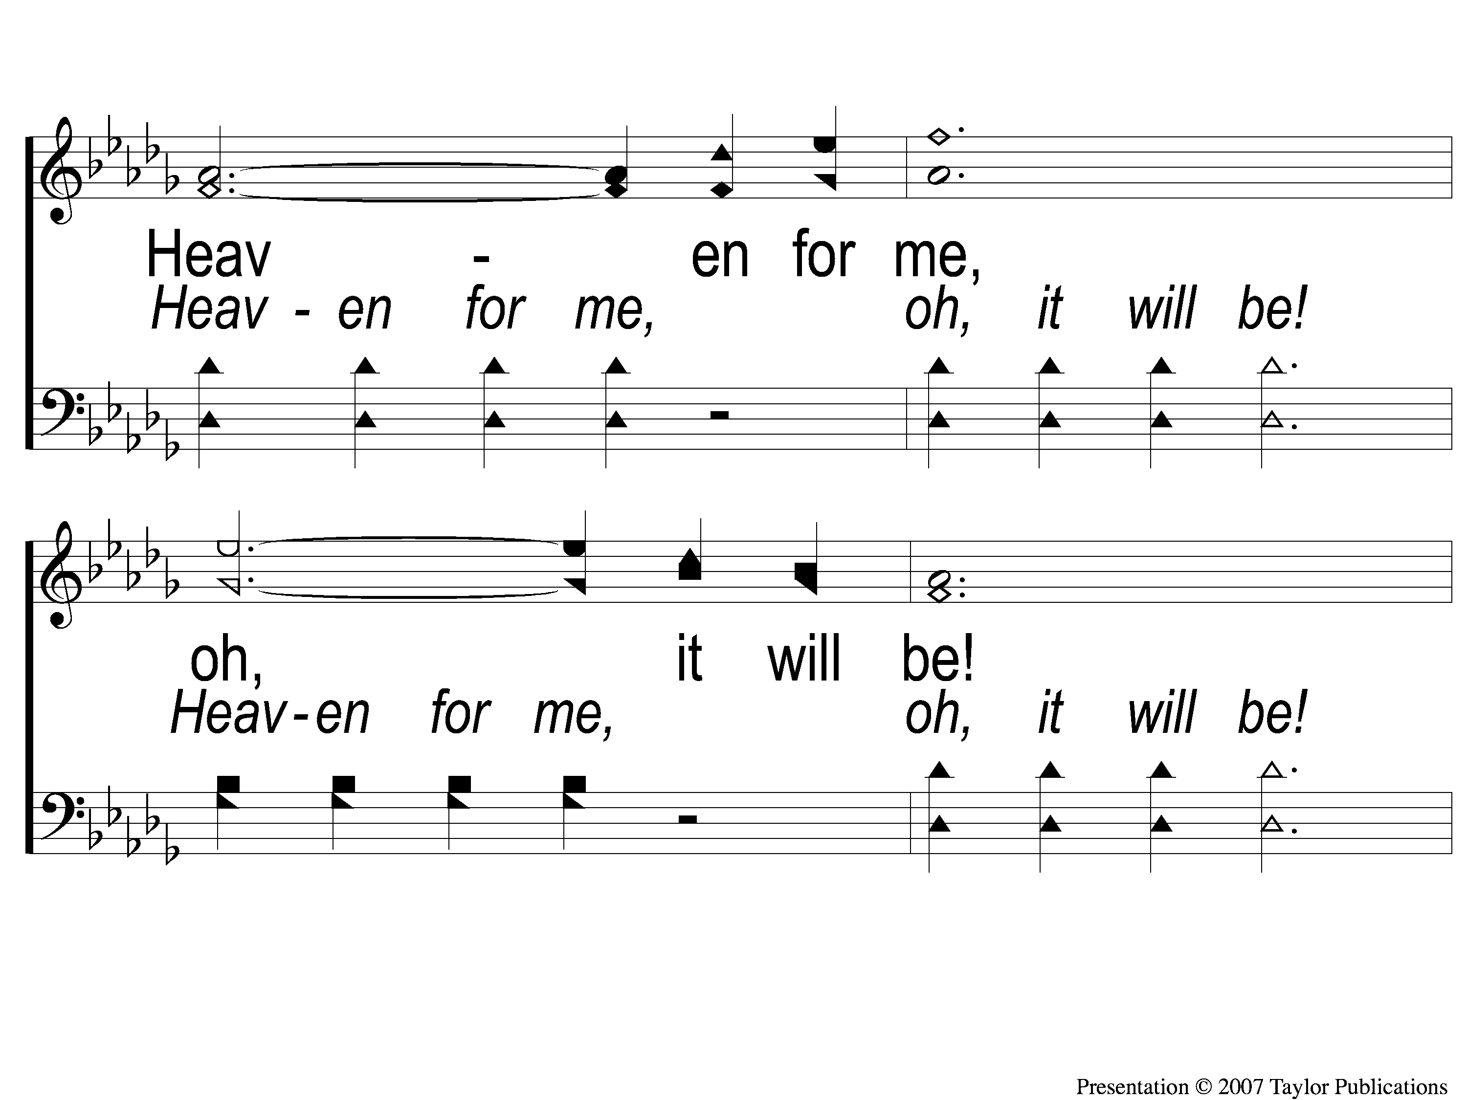
C-3 When Day of Toil Have All Gone By
When Days of Toil Have All Gone By
176

Slide 6
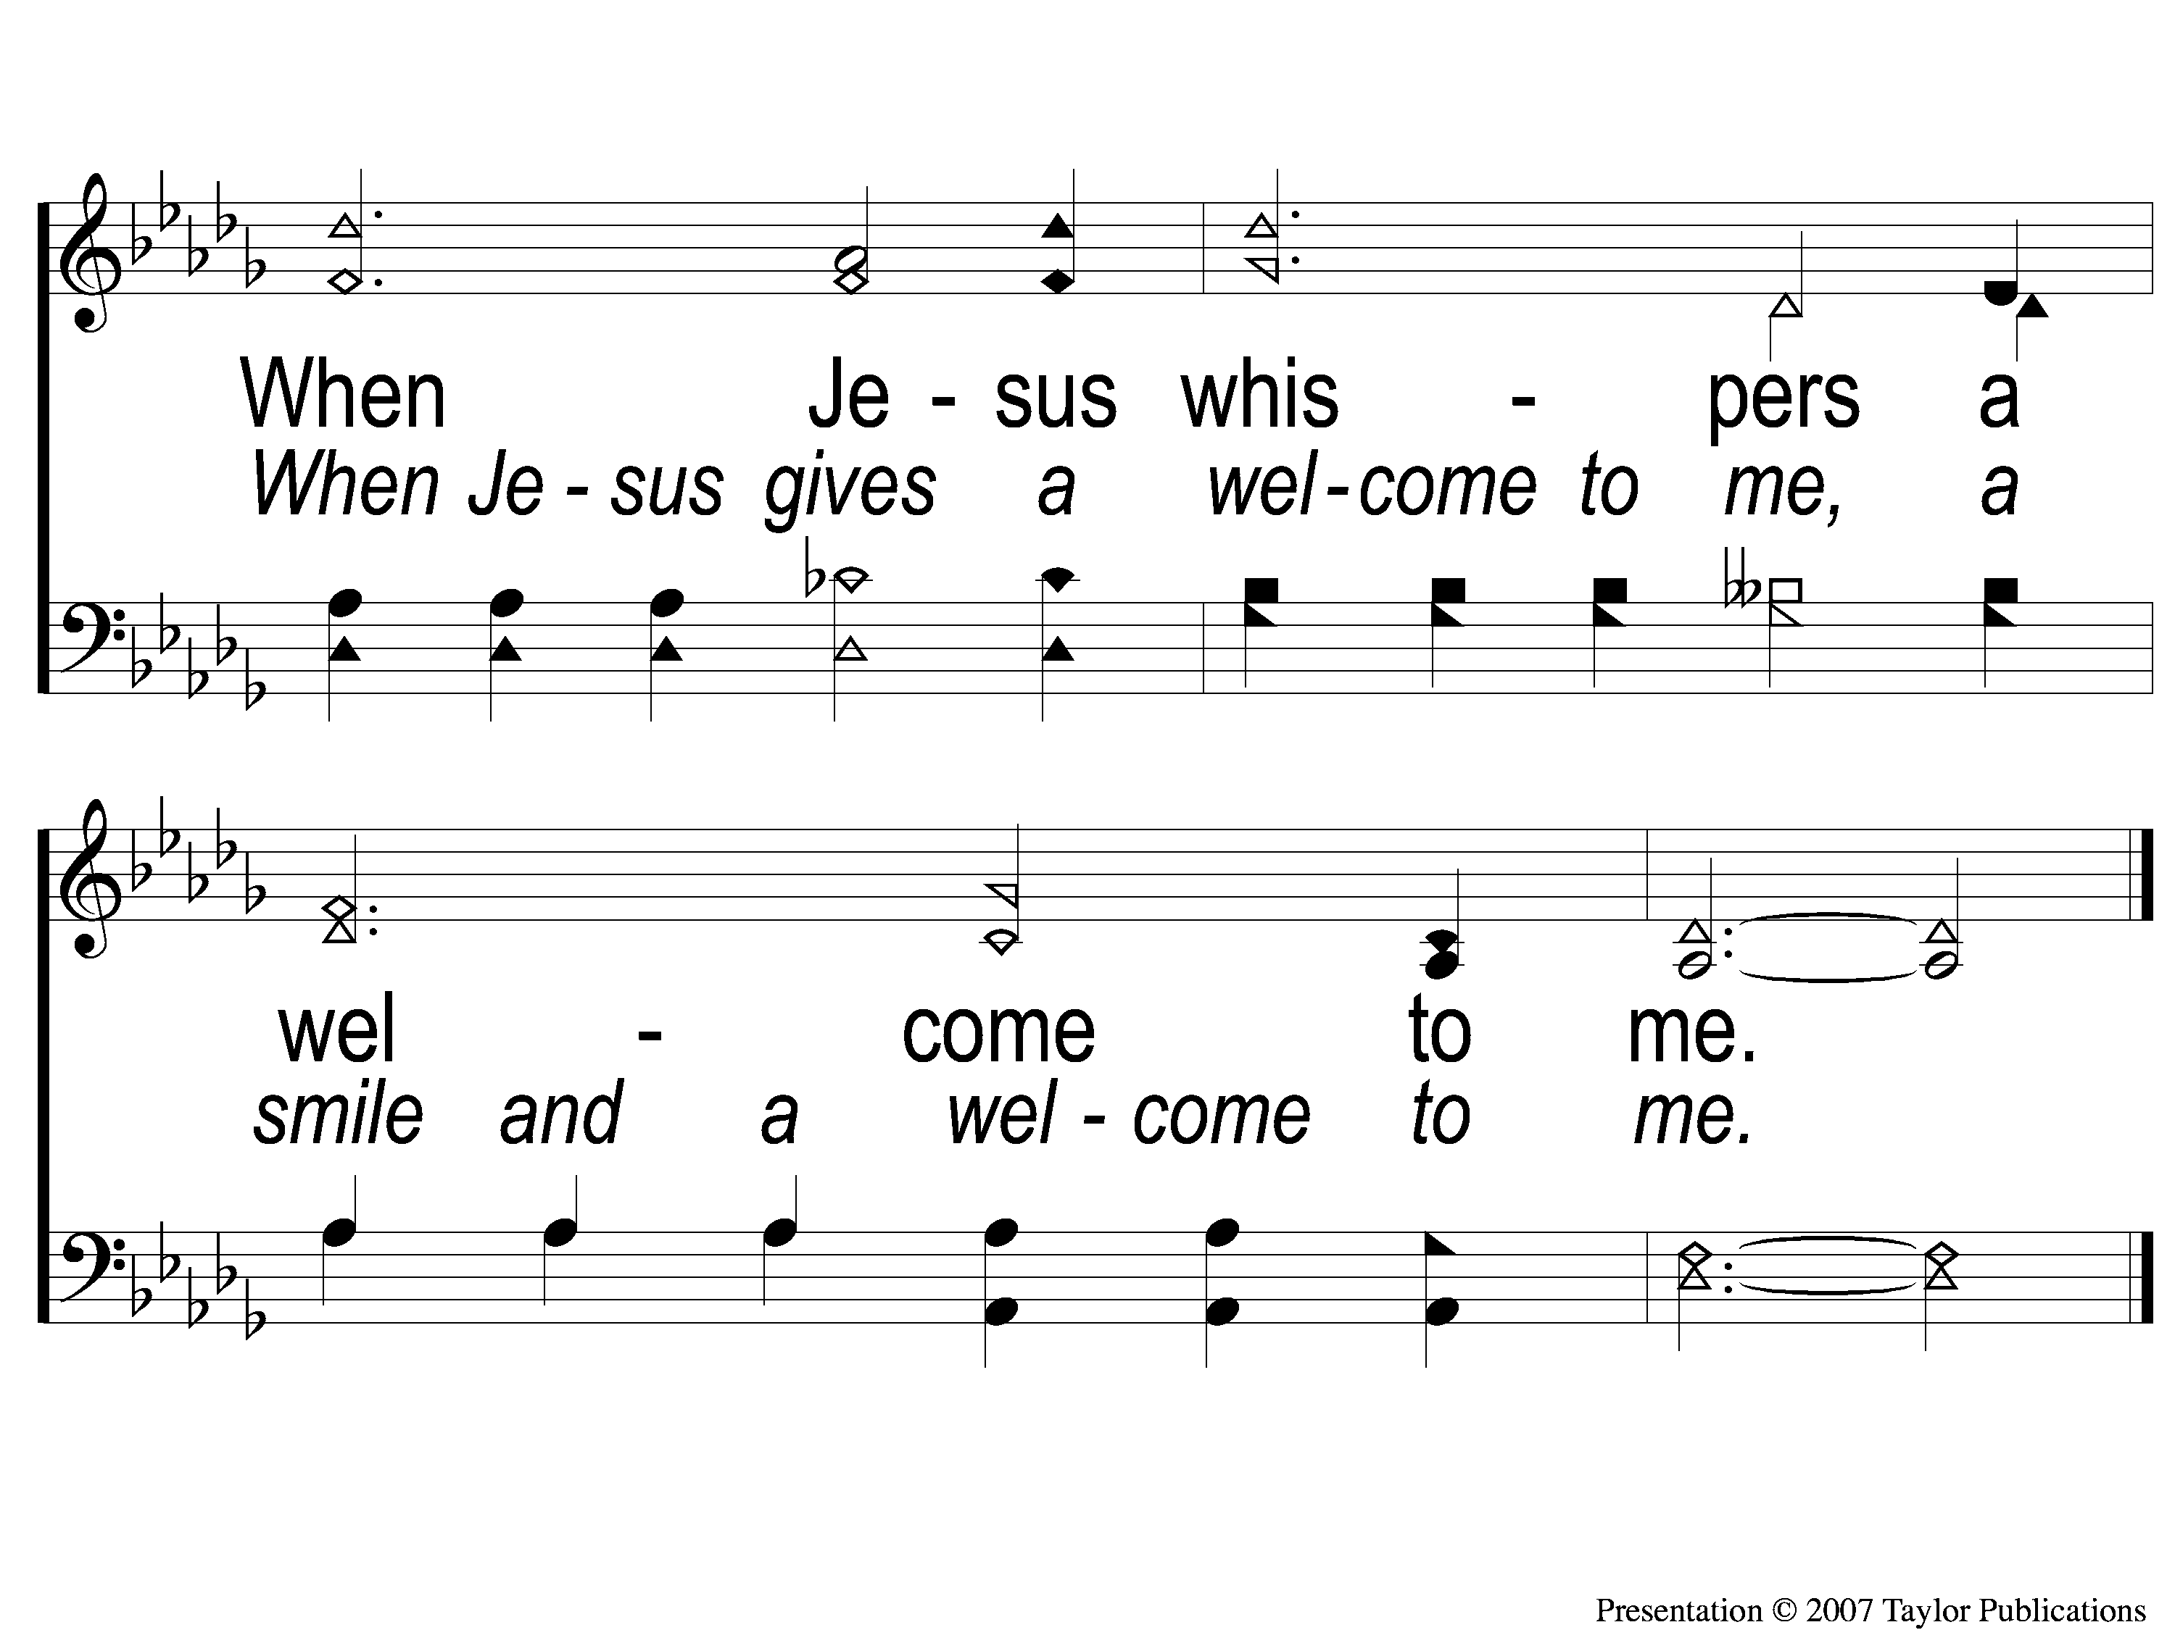
C-4 When Day of Toil Have All Gone By
When Days of Toil Have All Gone By
176

Slide 7
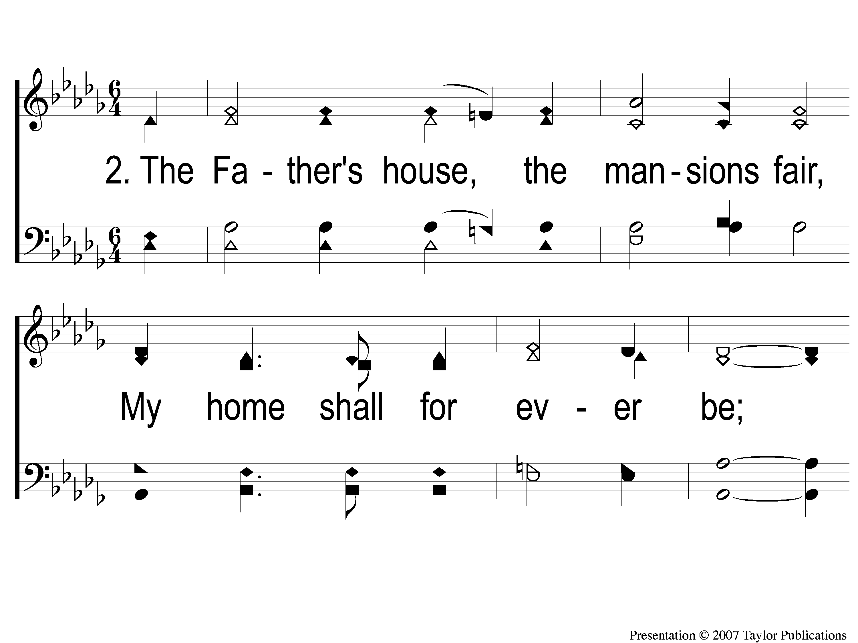
2-1 When Day of Toil Have All Gone By
When Days of Toil Have All Gone By
176

Slide 8
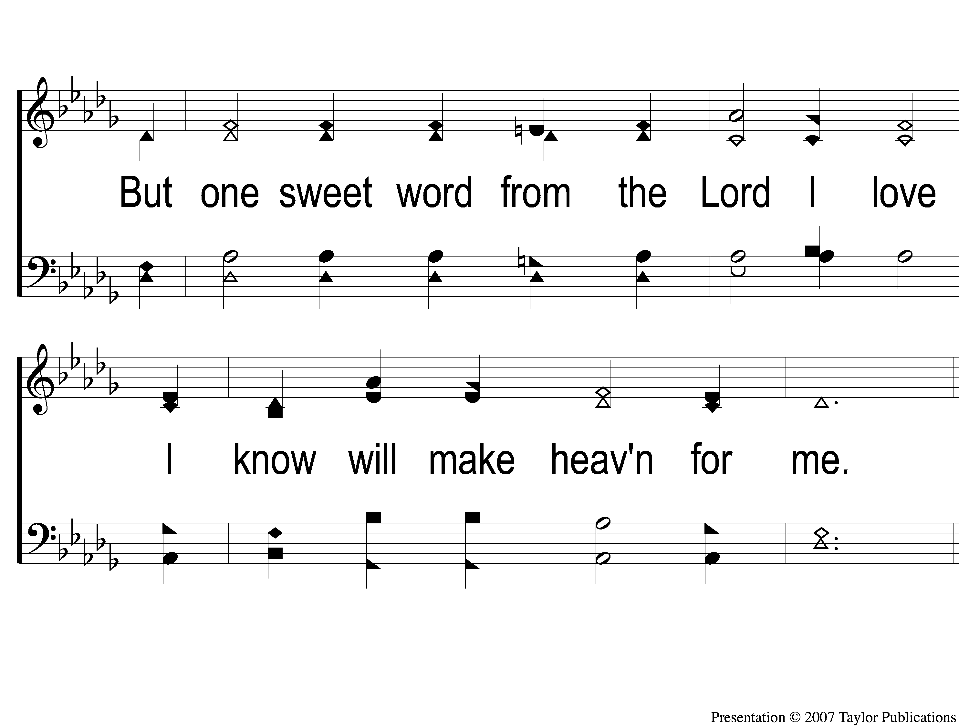
2-2 When Day of Toil Have All Gone By
When Days of Toil Have All Gone By
176

Slide 9
C-1 When Day of Toil Have All Gone By
When Days of Toil Have All Gone By
176

Slide 10
C-2 When Day of Toil Have All Gone By
When Days of Toil Have All Gone By
176

Slide 11
C-3 When Day of Toil Have All Gone By
When Days of Toil Have All Gone By
176

Slide 12
C-4 When Day of Toil Have All Gone By
When Days of Toil Have All Gone By
176

Slide 13
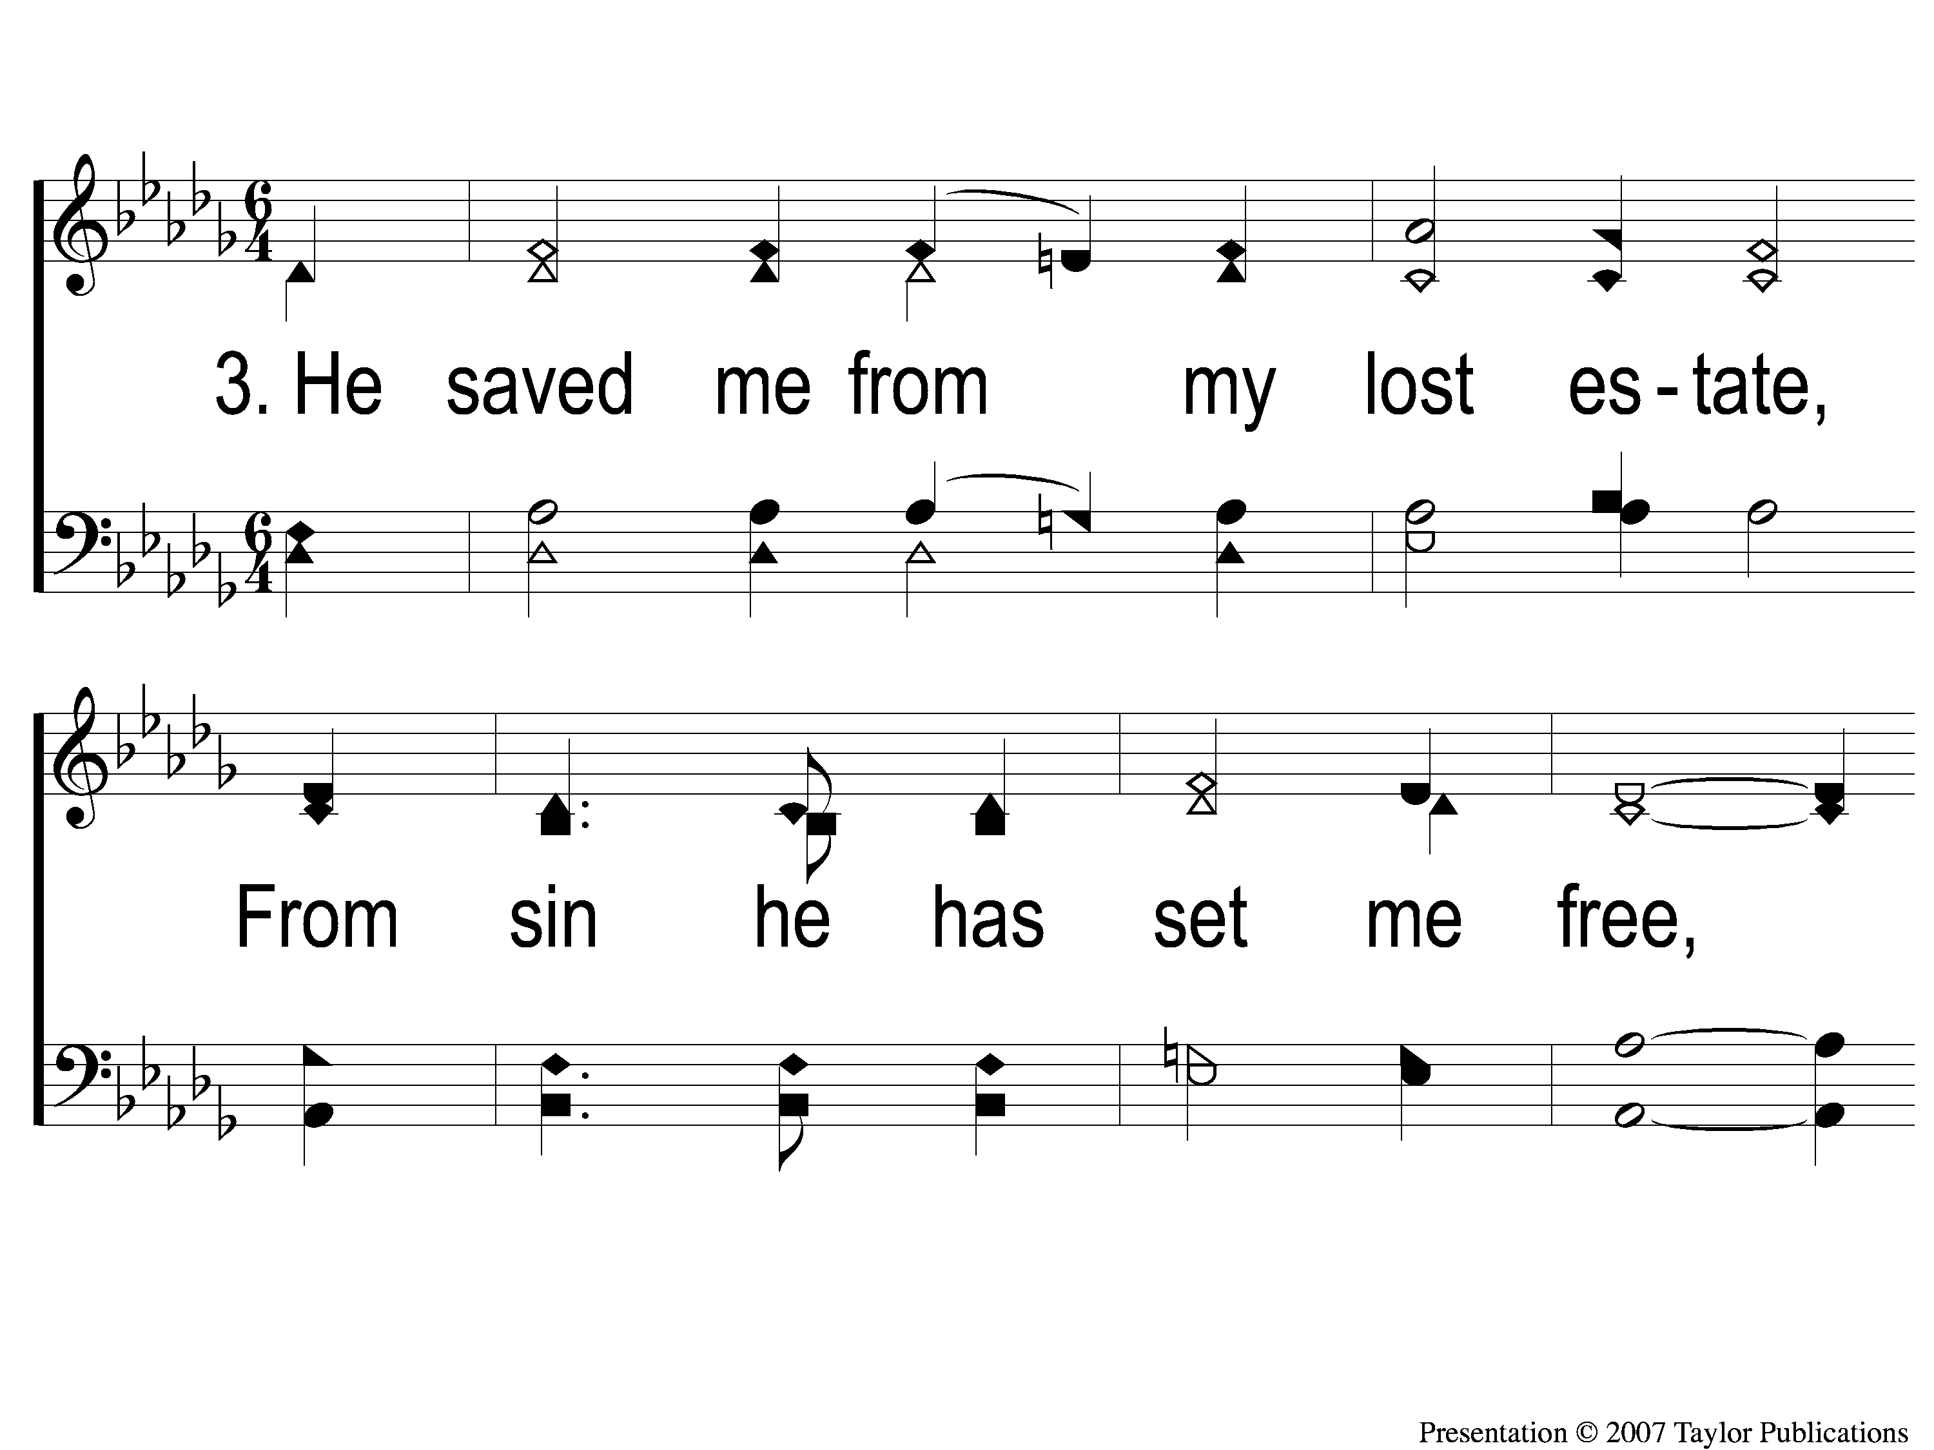
3-1 When Day of Toil Have All Gone By
When Days of Toil Have All Gone By
176

Slide 14
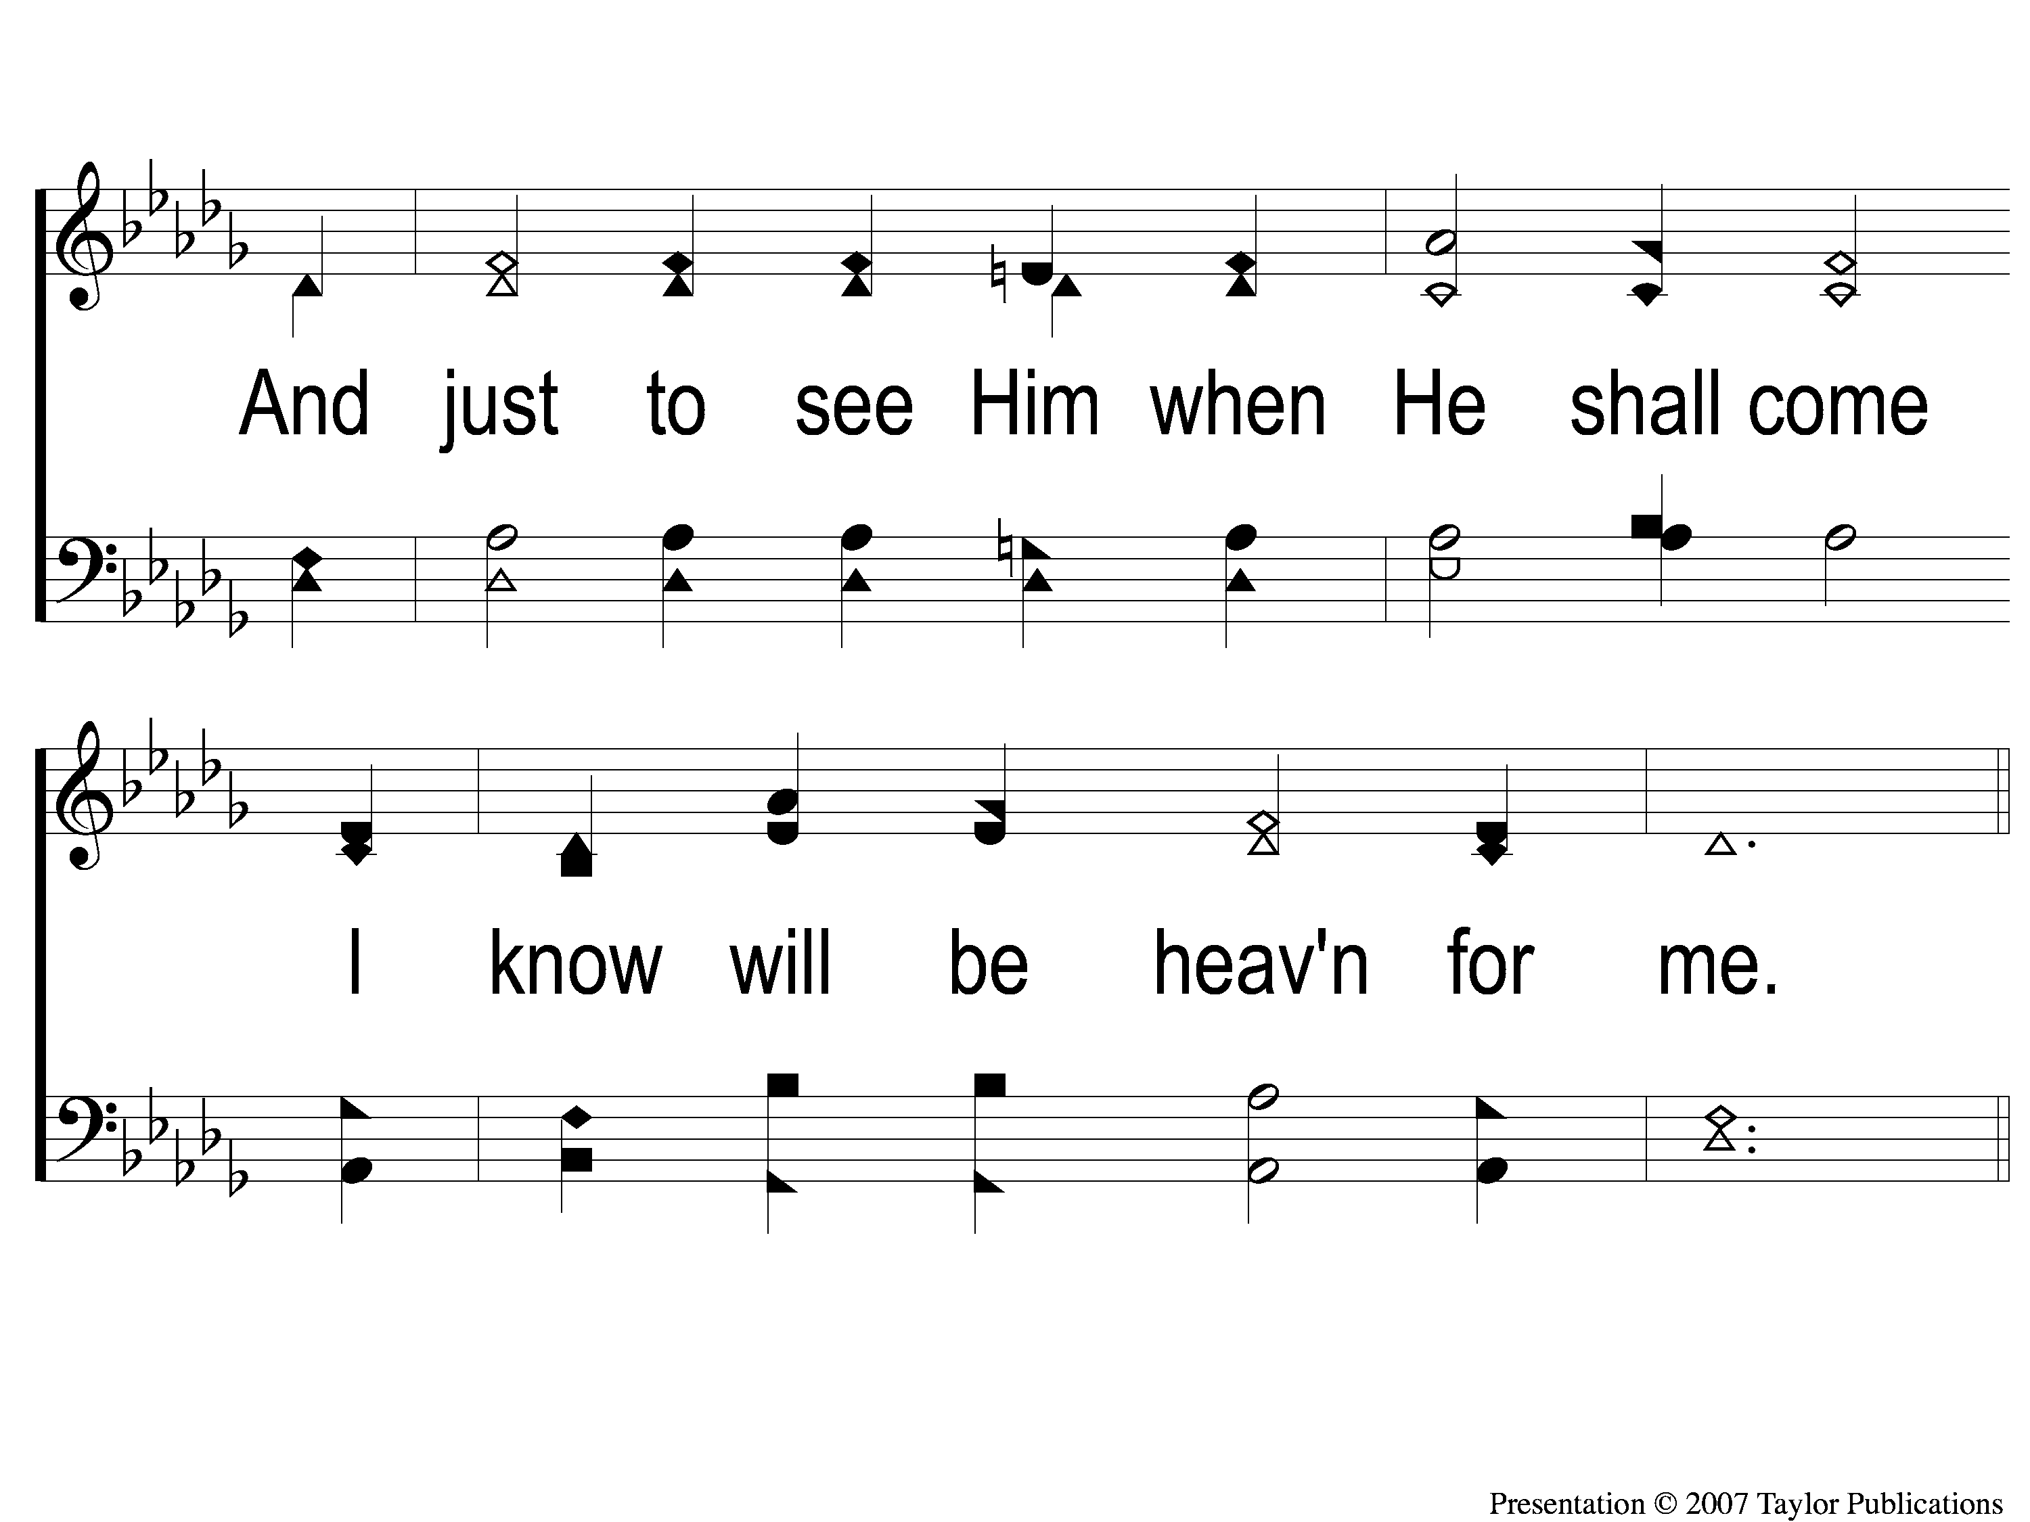
3-2 When Day of Toil Have All Gone By
When Days of Toil Have All Gone By
176

Slide 15
C-1 When Day of Toil Have All Gone By
When Days of Toil Have All Gone By
176

Slide 16
C-2 When Day of Toil Have All Gone By
When Days of Toil Have All Gone By
176

Slide 17
C-3 When Day of Toil Have All Gone By
When Days of Toil Have All Gone By
176

Slide 18
C-4 When Day of Toil Have All Gone By
When Days of Toil Have All Gone By
176

